Slide 1

It’s All About Me From Big Data Models to Personalized Experience
Yao Morin, Ph.D.

Slide 2
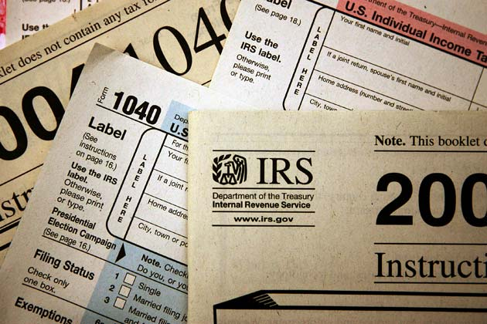
Go from this…

Slide 3
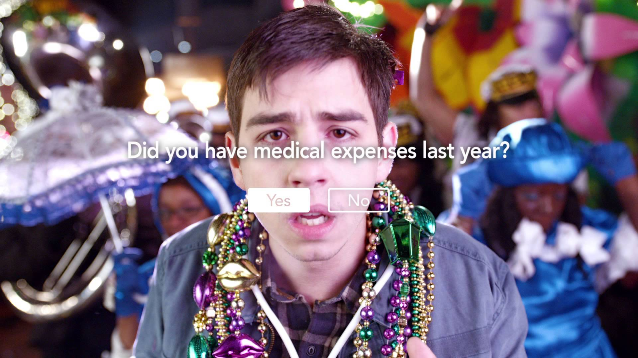
… to this …

Slide 4


Slide 5
30 Million users filed their taxes with TurboTax
5 Million used desktop
25 Million used online
TurboTax is 25 years old
Roots as a Desktop App (and old)

Slide 6

SERVICES

Slide 7
Business Logic and TurboTax
Hard-coded business logic
Fixed UI flow
Domain knowledge embedded

Slide 8
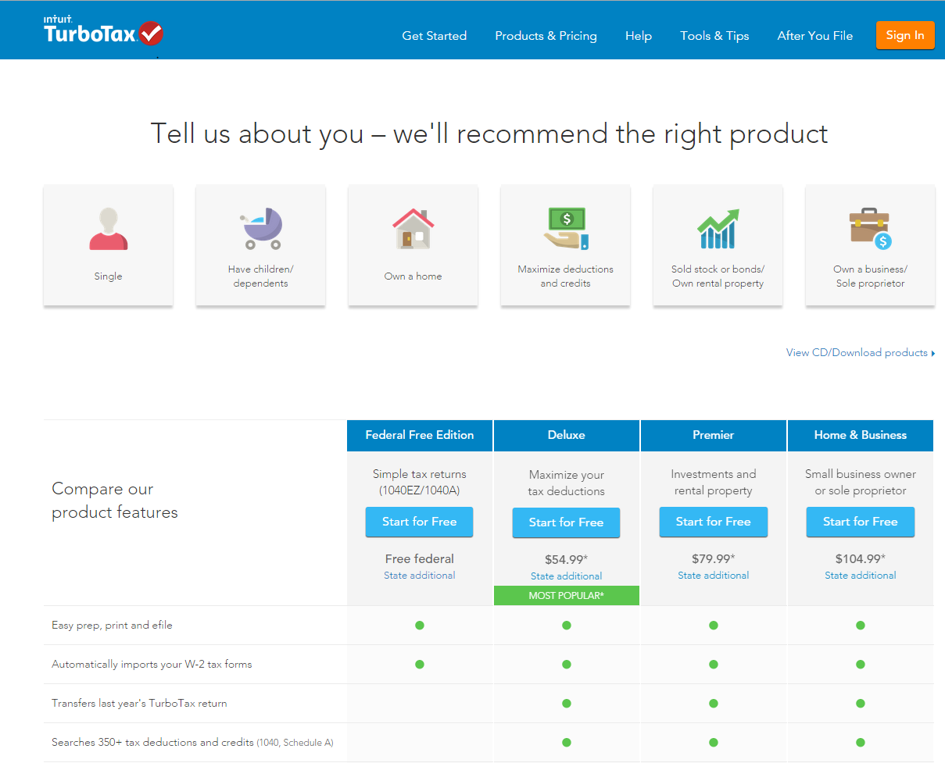
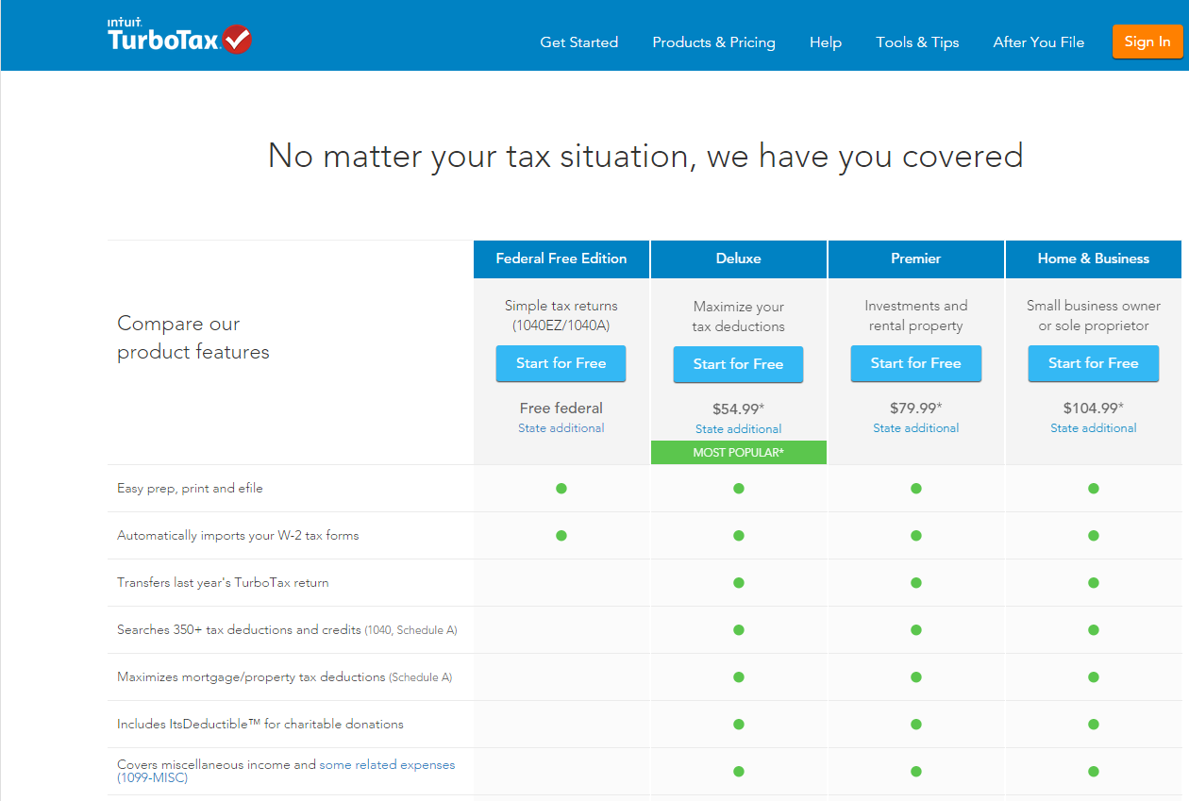
Experience A
Experience B
We know what you PREFER

Slide 9

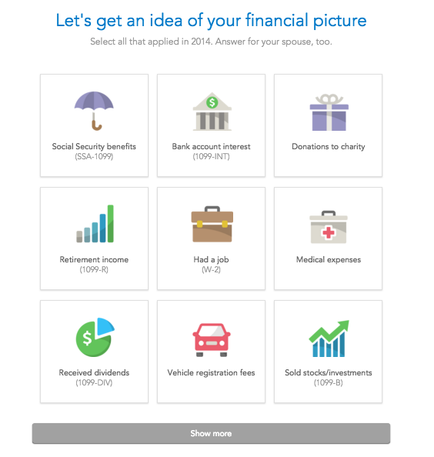
We serve up what’s RELEVANT to you

Slide 10
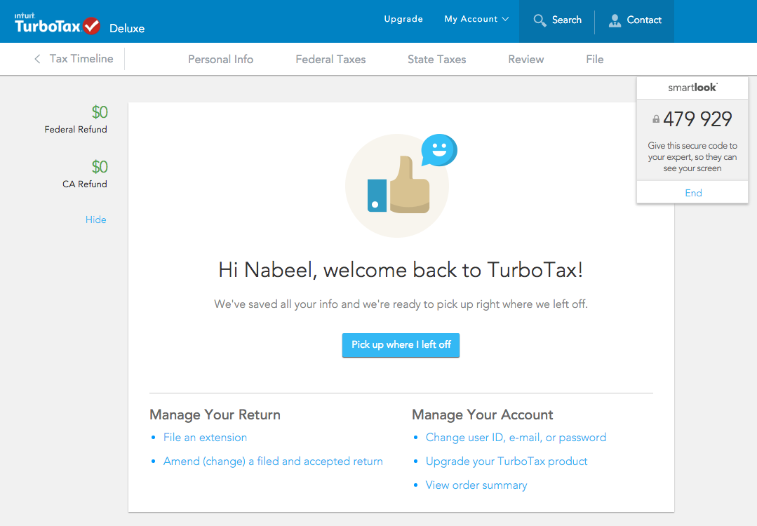
We know when you need HELP

Slide 11

How can we tailor the experience just for YOU?

Slide 12

Marriage between Data Science and Dynamic and Responsive Frontend

Slide 13
What is Data Science?
It is multidisciplinary study and incorporates various techniques and theories from many fields, such as statistics, mathematics, artificial intelligence, data engineering, etc.
Answers questions based on data instead of assumptions
extract meaning from data and explain phenomenon
uncover patterns from data and develop predictive models

Slide 14
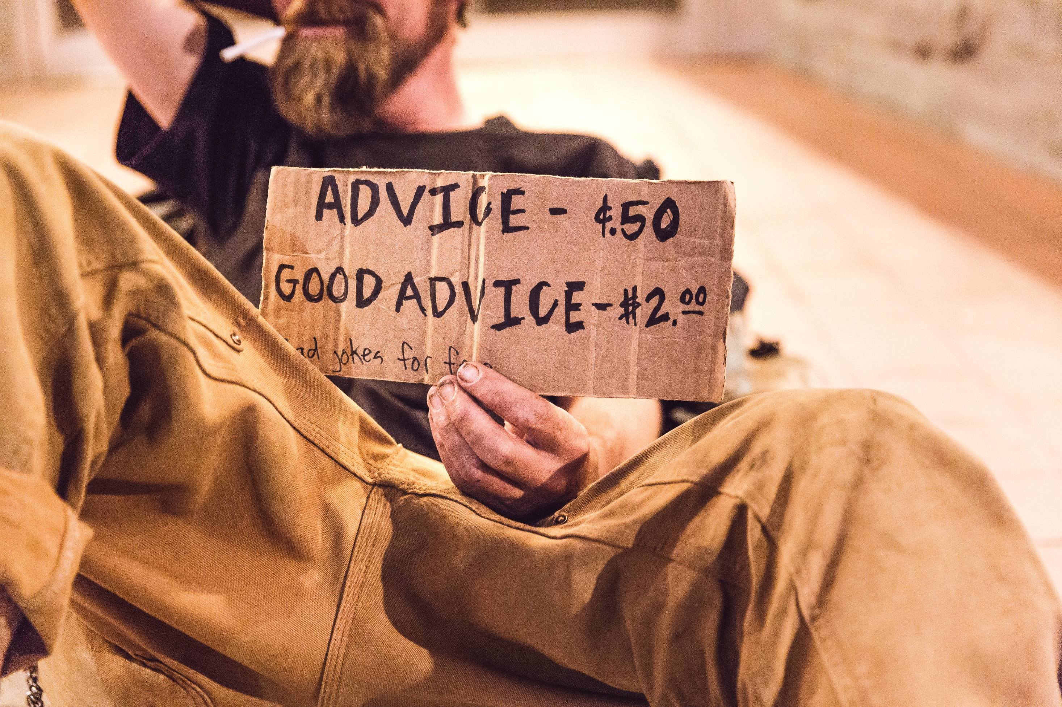

Slide 15
From business problems to models
E2E goals definition
Result analysis
Model KPI, Input/ Output definition
Online evaluation
Model creation and offline evaluation
Training/ test set preprocessing
KPI measurement/ accuracy assessment
Algorithm & method selection
Model training/ parameters selection
Integration/ Experience QA
Online model coding & validation

Slide 16
Data model building cycle
Training/ test set preprocessing
KPI measurement/ accuracy assessment
Algorithm & method selection
Model training/ parameters selection

Slide 17
Identify data
Features - what information do you have
From data inventory and/or domain experts
Examples: Demographic, behavioral or geographic data, etc.
Labels ( for supervised learning ): what you want to predict
What kind of products to recommend
Whether a customer buys a product
How a customer reacts to an experience

Slide 18
Pre-processing data
“Encoding” categorical data
ZIP code, feelings, occupations
dummy coding, bucketing, and others
Imputations – “filling in” missing data
ML estimations, stochastic regression, multiple imputation
Other cleaning

Slide 19
Model training
Learning the relationship between features and labels through data

Slide 20

Not this kind of relationship

Slide 21
But this kind of relationship
Labels = f(Features)
Regressors
Classifiers, etc.

Slide 22
Model evaluation
Evaluate model performance against model-specific performance metrics with hold-out data and iterate on
Model type
Hyperparameters
Features
…

Slide 23
Example: Training a model
User data
Training Set
Preprocessing
Model Training
(Random Forest)
Separate into training and validation sets
Model
Metric
Labels
Validation Set
Preprocessing
Model Validation
( FP/FN)

Slide 24
Advantages of data models
To have dynamic personalized experience, we need to decide what to show out of a large variety of possible experiences, in an algorithmic way.
Data models solve this:
Connect user data to user preferences
Machine learning is automated and handles the complexity

Slide 25
Limitations of data models
Uncertainties
May not be suitable when applications require 100% accurate
May need to build in safeguards for applications that require high accuracy
Vulnerable to inaccurate, missing or insufficient data

Slide 26
Traditional process flow
User Requests
Logic
Pages
Send information about the user
Dispatcher
If… else… logic blocks
Static flow
Static pages
Hide/show DOM elements

Slide 27
Dynamic process flow
User Requests
Model Service
Platform
Player
Send information about the user
Hosts models
Processes user requests based on user data received
Consume received decision and generate final user experience

Slide 28




Design With Data Science Mindset
Not Static
Configurable
Scalability
Maintainability
Data science and static do not mix
Do not hardcode paths/pages
Data science works well with configurable components
Use templates
Experiences should support large amounts of variability
Use templates (again!)
A refresh of design should not break underlying logic
Build experiences with separation of logic and design

Slide 29

How do we apply Data Science to TurboTax UI?

Slide 30

Dynamic Views
Traditional Dynamic UI
Truly Dynamic UI
Dynamic Data
Dynamic Data
+
+
{ ^{type: template} }
Dynamic Semantic Templates
Static Templates
=
=
Dynamic Site
Dynamic Site

Slide 31
Dynamic Flow
Statically Defined Routes/States
Dynamic Finite State Machine
Relationships between pages are pre-determined
Entry points into the app are pre-determined
All flow and variation in the application is hard coded
Relationships among data are pre-determined
Entry points are determined dynamically
Flow though the application is completely data driven

Slide 32
FUEGO
Data science model enabled
Semantically defined dynamic experiences
Dynamic application flow
Device agnostic representation of the UI
Device specific applications to render the UI

